Slide 1

Authoring platform for professional writing
Iris Hsu
Regional Product Manager, iGroup
Nov 2016

Slide 2
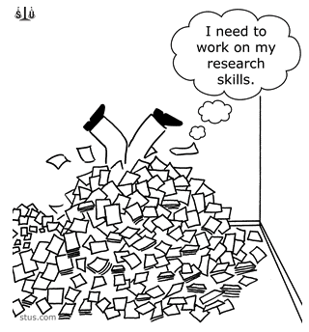
The challenges of writing papers
Identify the objectives
Review the literatures
Specify the purpose
Collect data
Analyze & interpret
Write the interpretation

Slide 3


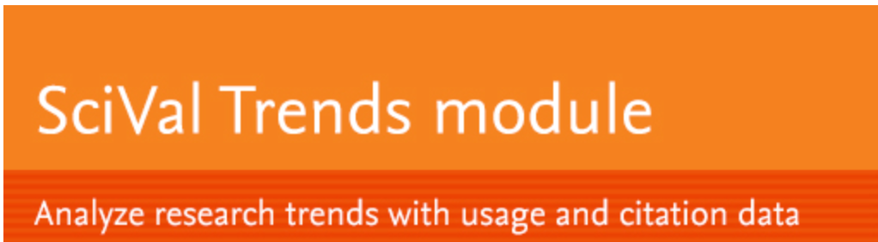



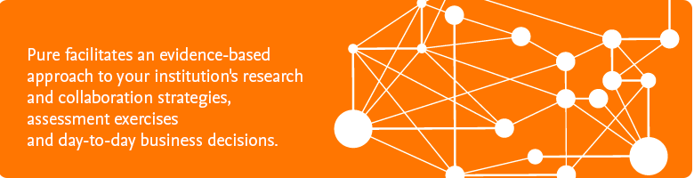


“Too many tools, too many contents!”

Slide 4


Research Best Practice, or
Research 1-2-3
1. Authoring
Smart discovery
2. Publishing
Writing the manuscript
3. Marketing
Conferences
Originality check
Networking
Reference management
Collaboration
Use of technology
Publishing strategy
Level of interdisciplinarity

Slide 5
Research Best Practice, or
Research 1-2-3
1. Authoring
Smart discovery
2. Publishing
Writing the manuscript
3. Marketing
Conferences
Originality check
Networking
Collaboration
Use of technology
Publishing strategy
Level of interdisciplinarity
Reference management

Slide 6
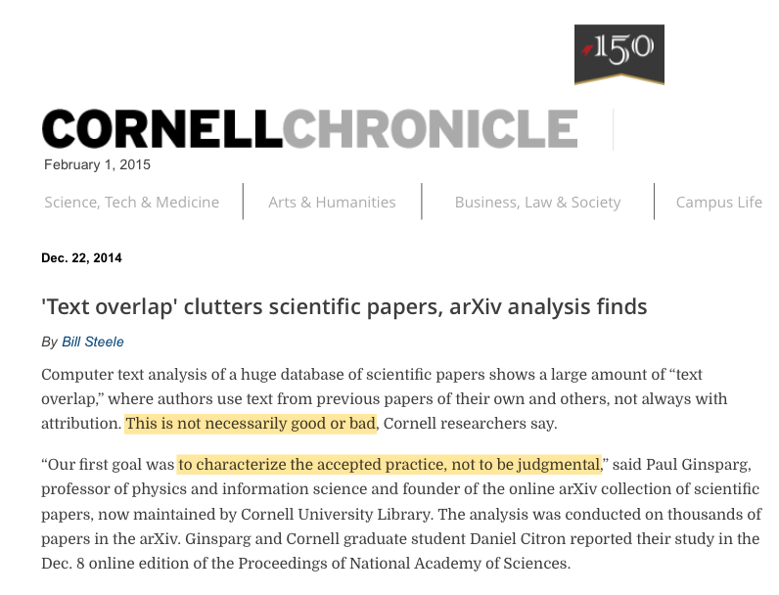
Originality Checking is a MUST for Publishing
“Overlapping” or text similarity is not unusual in the ocean of information even across disciplines
There is a need of originality check while work are in-progress
Source: Bill Steele, “’Text overlap’ clutters scientific papers, arXiv analysis finds”, Cornell Chronicle, February 2014 http://www.news.cornell.edu/stories/2014/12/text-overlap-clutters-scientific-papers-arxiv-analysis-finds

Slide 7
Most Plagiarism are unintentional
Plagiarism
Self plagiarism (e.g. duplicate publication) & self citation
“Salami slicing”
Publishing everything versus selective publishing
Intentional or unintentional?
Source: Marcel A. L. M. van Assen et al, “Why publishing everything is more effective than selective publishing of statistically significant results”, journals.plos.org
Ghost authorship
Fraud
Highly
intentional

Slide 8





Networking for feedbacks or collaboration
Feedbacks to improve the ideas
Identify the objectives
Review the literatures
Specify the purpose
Collect data
Analyze & interpret
Write the interpretation
Peer-to-peer
community
Peer reviews to validate the work
Publication

Slide 9



Reference management
Reference management tools provide different bibliographic styles
To go beyond, most reference management tools include:
  Search capability;
  Collaborating platform; and
  Document management
What if we include originality check?

Slide 10
Streamline the research workflow
Write
Embed all the essential research best practices onto a single authoring platform
Encourage the usage of peer-reviewed articles from both Open Access and non-Open Access
From plagiarism check to originality check for better ideas: knowledge iteration
Integrated authoring platform
Reference management
Community platform
Citation
Search
Originality check
Peer review process
http://www.EEWOWW.com
Dissemination

Slide 11

Authoring Activities comprise all the essential best practices including
Authoring
Searching for Relative Info
Document management
Originality checking
Texting & Writing
Generating Reference List
Sharing & Collaboration
Formatting for the paper
One Single Platform
for
ALL
Best Practices

Slide 12
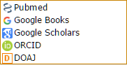
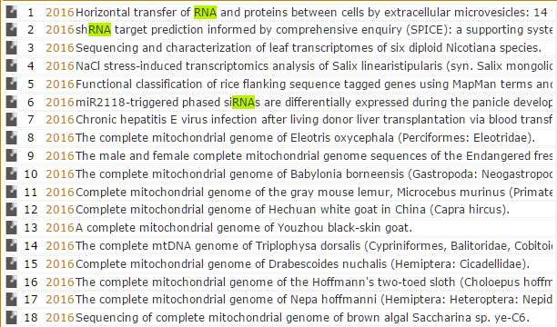
Searching
Perform Keyword Search in -
Get Search Results -

Slide 13
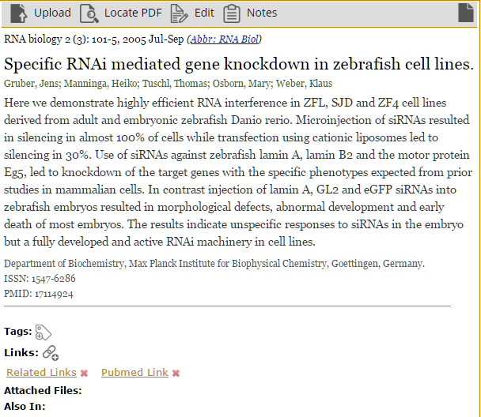
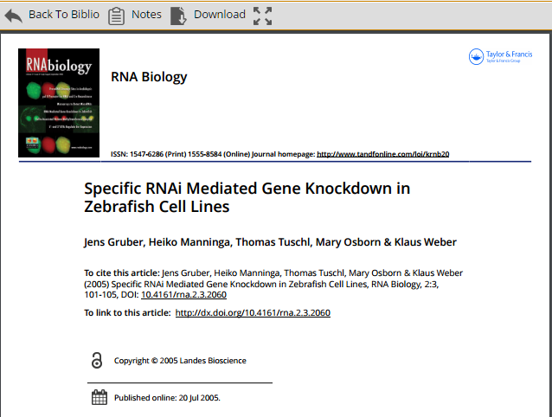
Searching
View Detailed Information -
Get the Fulltext Immediately -

Slide 14
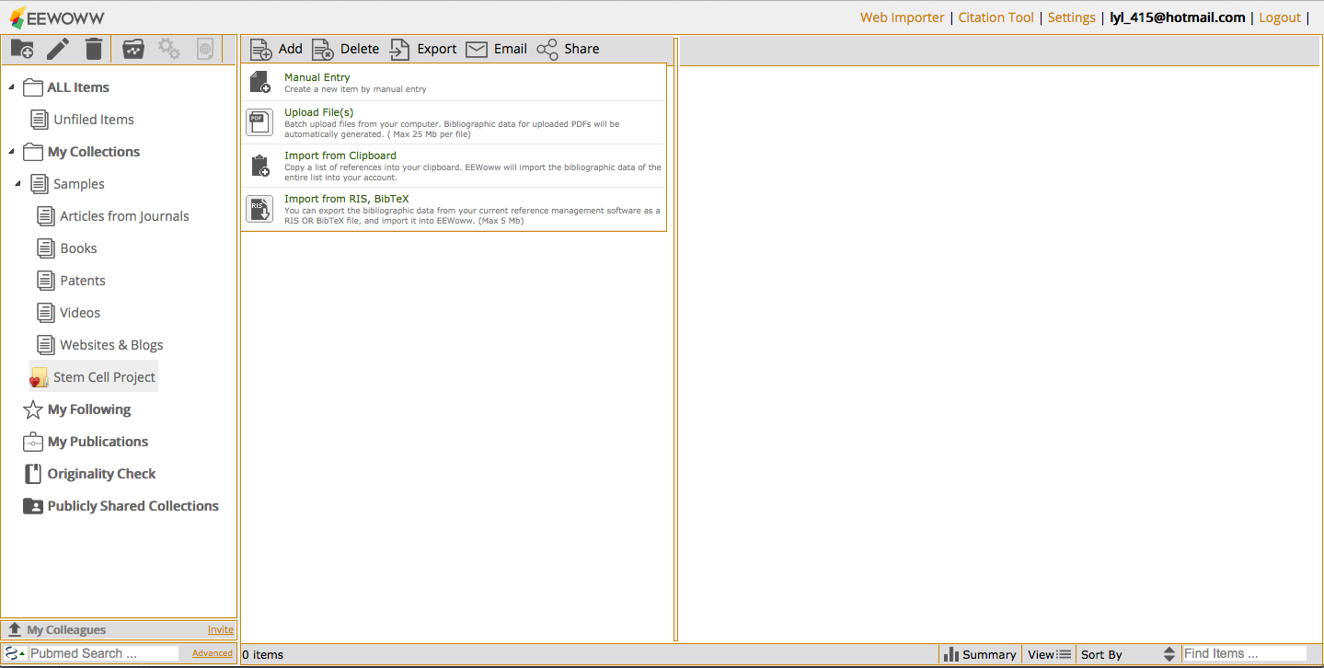
Document Management
Add & Manage data in Multiple Ways

Slide 15
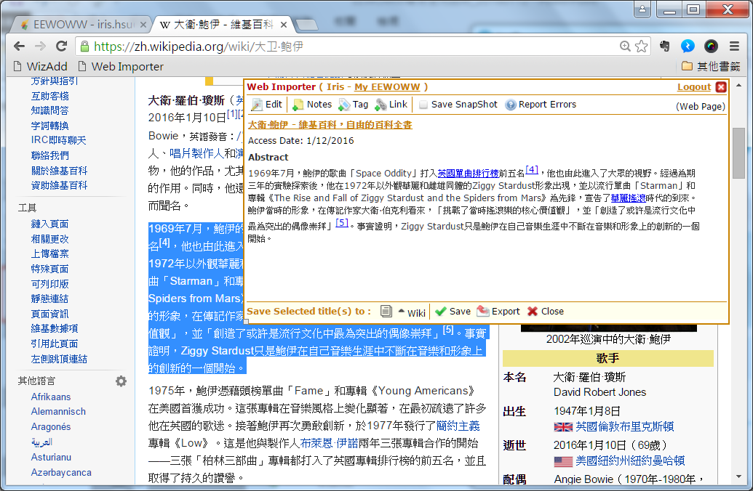
Document Management
Web Importer Allows Users to
Add Selected Text of Webpage

Slide 16
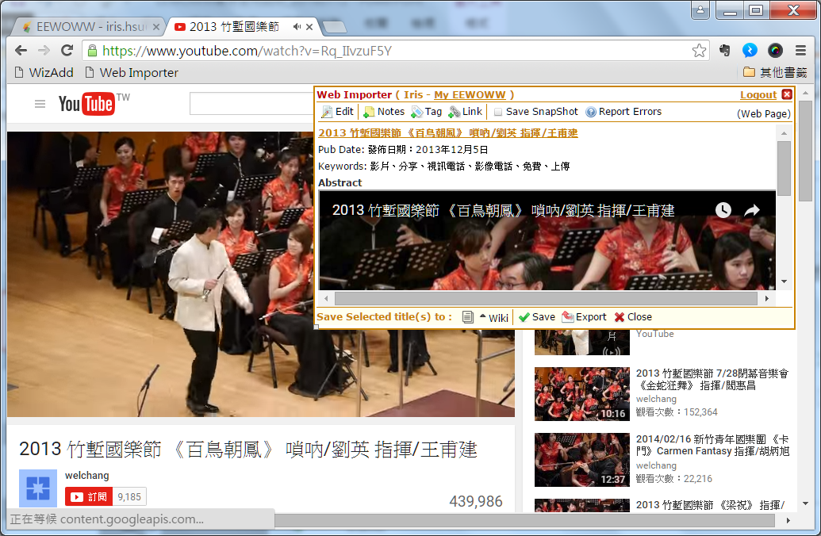
Document Management
Streaming Video can be Added Directly

Slide 17
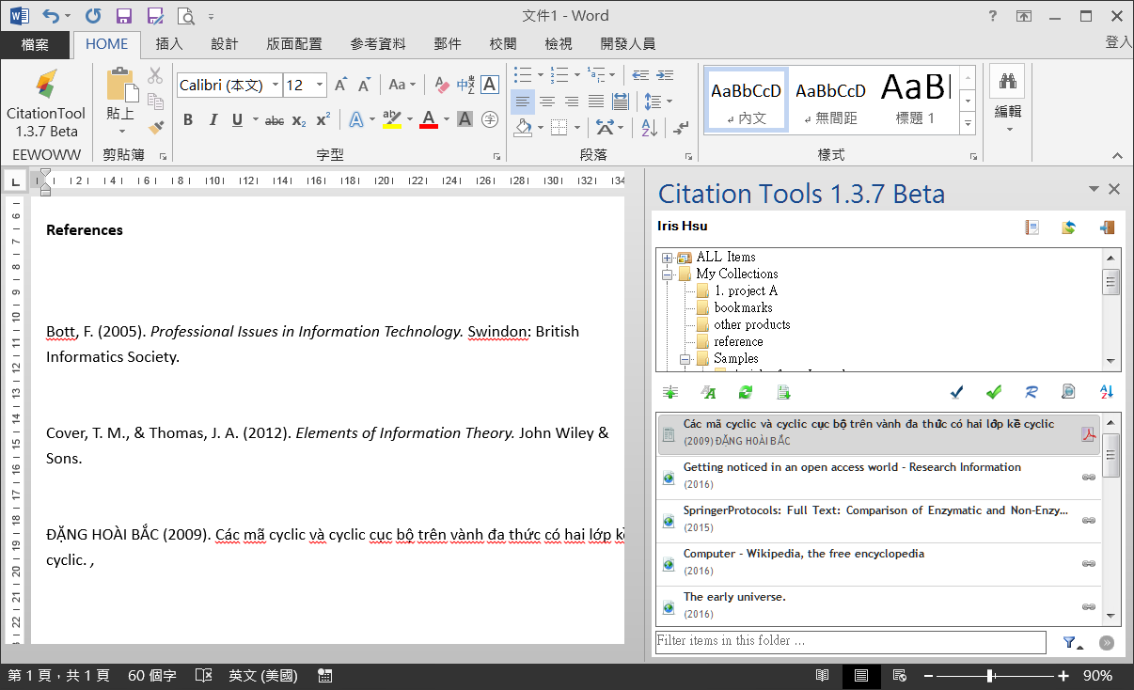
Texting
&
Writing
Embed in MS Word for Easy Retrieving

Slide 18
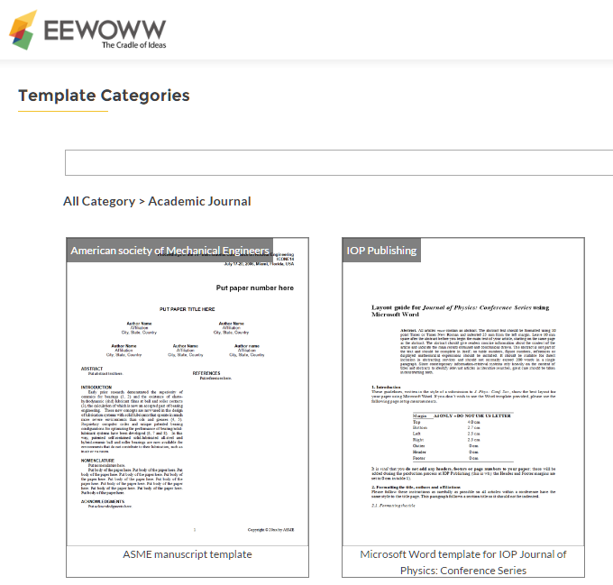
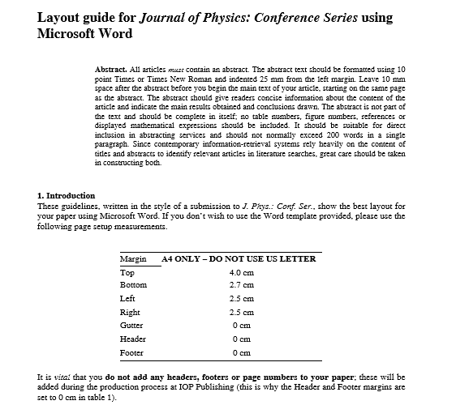
Formatting
Document Templates for Various
Purposes are Available

Slide 19
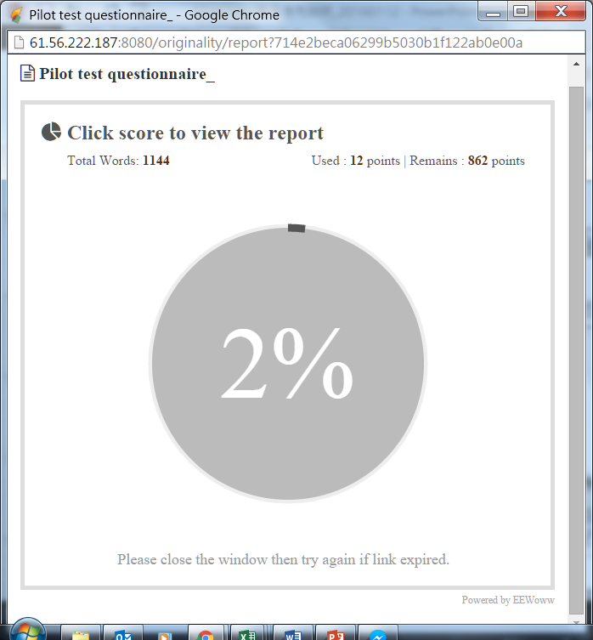
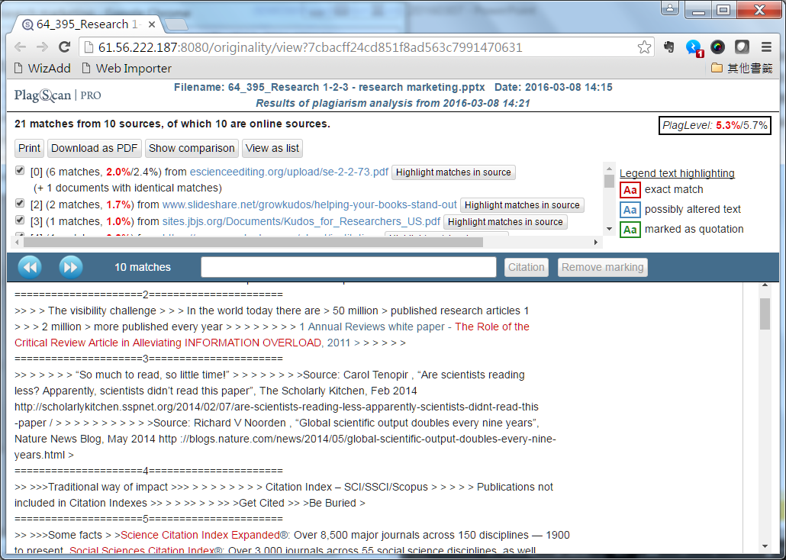
Originality
Checking
Documents can be uploaded for
Originality Checking
Similarity Report is presented
Immediately for review

Slide 20
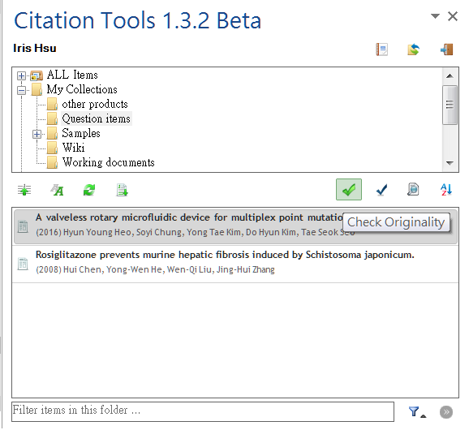
Originality
Checking
Documents can also be Checked in
MS Word during Writing

Slide 21
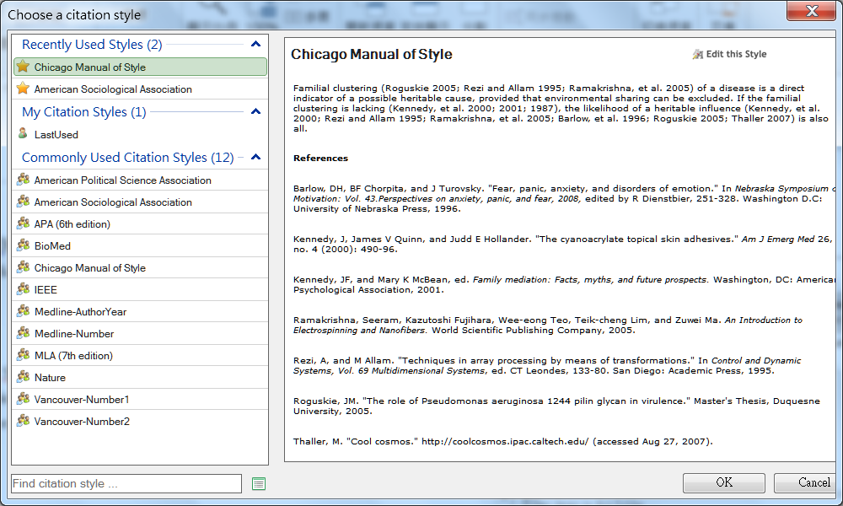
Referencing
Thousand of Citation Style to be Selected

Slide 22
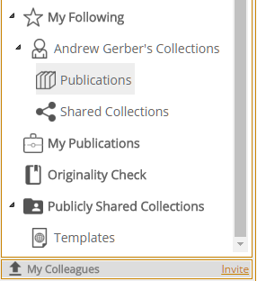
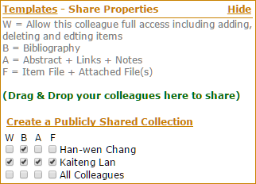
Sharing
Follow Others & Get
Latest Updates of Ideas
Different Level of Sharing for Different People

Slide 23
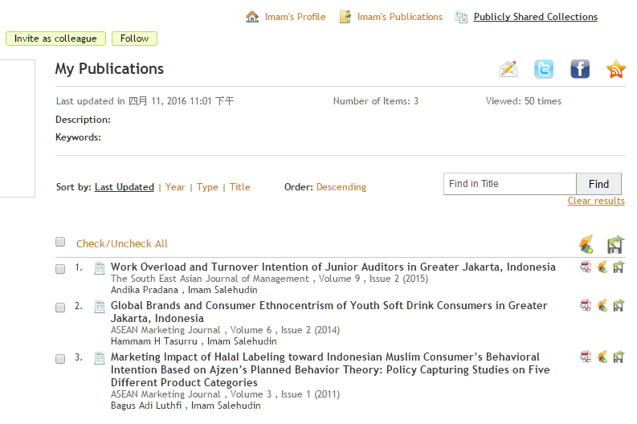
Sharing
Public Profile Page for Every User

Slide 24





